Slide 1
TEMPLATE METHOD pattern
CSE 776 – Design Patterns, Fall 2017
Akshay
Manasa Malali Nagabhushana
Rama Teja Repaka

Slide 2
Intent
Template Method pattern defines a sequence of steps of an algorithm.
The subclasses are allowed to override the steps but not allowed to change the sequence
Template method pattern is that we put the general logic in the abstract class, and let
the subclasses define the specifics

Slide 3
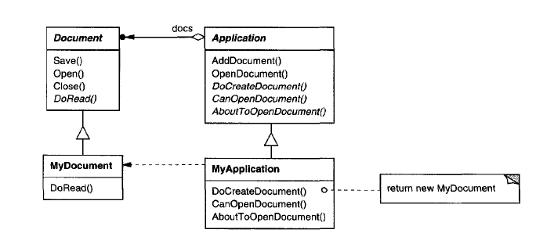
Motivation

Slide 4
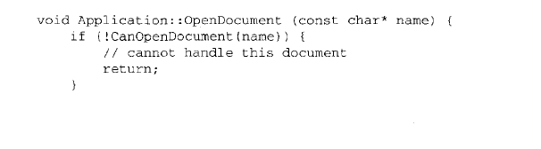
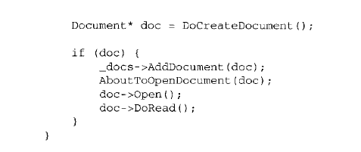
Motivation

Slide 5
Motivation
We call OpenDocument a template method
Because OpenDocument defines each step for opening a document.
Step1: It checks if the document
If can be opened,
Step2: creates the application-specific Document object,
Step3:adds it to its set of documents,
Step4:reads the Document from a file.

Slide 6
Applicability
A template method in C++ may contain
virtual method which may or may not override
pure virtual function which has to be overridden in the sub class
private method which cannot be overridden
Similarly in Java
A template method contain in java
abstract method which has to be overridden (like pure virtual function in C++)
final method which cannot be overridden (like private method in C++)
normal public method which may or may not override(like virtual method in C++)

Slide 7
Applicability
To implement the invariant parts of an algorithm once and leave it up to
subclasses to implement the behavior that can vary.
when common behavior among subclasses should be factored and localized
in a common class to avoid code duplication.

Slide 8
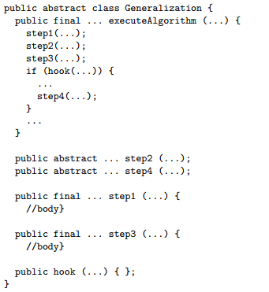
Applicability
If any Sub class want to skip some of the steps then they can write hook operations in the abstract class which is shown below.

Slide 9
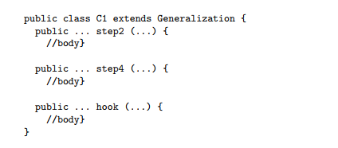
Applicability
Sub classes can override the hook method to provide their own implementations
So it can provide the step4 definition if they don’t want then return False in hook method

Slide 10
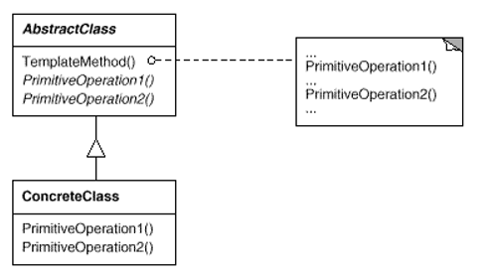
Structure

Slide 11
Participants
Abstract Class
Defines abstract primitive operations that concrete subclasses define to implement steps of an algorithm.
Implements a template method defining the skeleton of an algorithm.
Concrete Class
Implements the primitive operations.

Slide 12
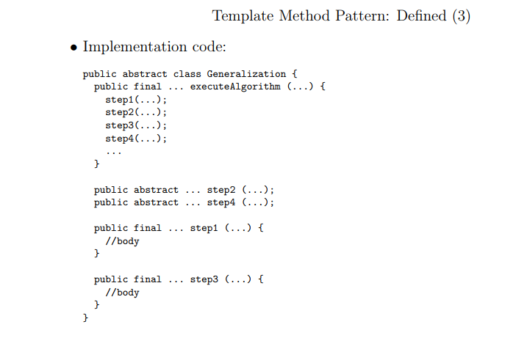

Slide 13
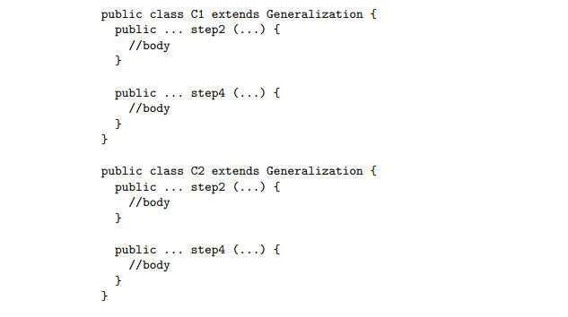

Slide 14
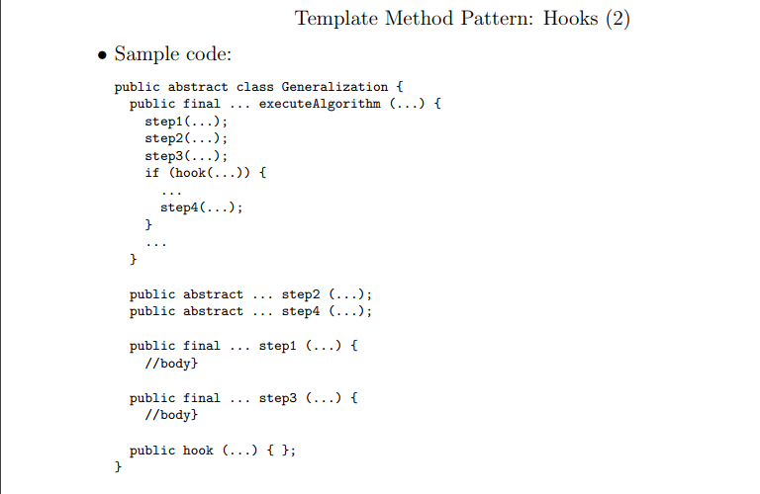

Slide 15
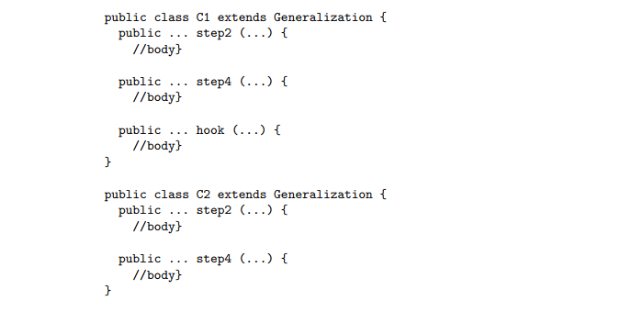

Slide 16
Collaborations
Concrete Class relies on Abstract Class to implement the invariant steps of the algorithm.
Consequences
Pros:
Fundamental technique for code reuse.
Flexibility lets subclasses decide how to implement steps in an algorithm.
Optional steps through Hook operations.

Slide 17
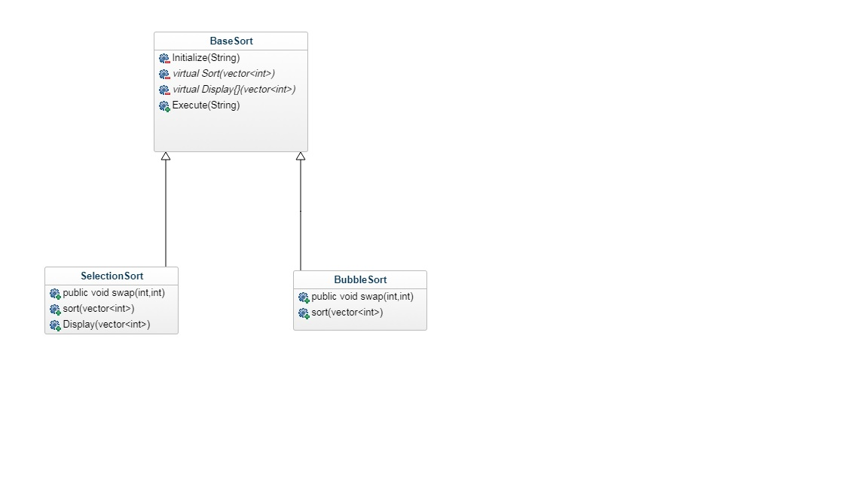
Class diagram

Slide 18
Known Uses
Comparing different activation functions(NN algorithms)
Mostly used in scientific experiments
Many tools use a variation of this pattern

Slide 19
Related Patterns
Strategy Pattern:
  Varies the entire algorithm unlike the template method pattern which varies part of the algorithm
Factory Method Pattern:
  Specialization of template method pattern.
  Methods in template method which are to be overridden are very often Factory methods.

Slide 20
References
Design Patterns, Elements of Reusable Object-Oriented Software, Erich Gamma, et. al., Addison-Wesley

